Slide 1
Data Structures
Linked Lists

Slide 2
Arrays are used for storing same type data elements in memory.
An array is allocated fixed amount of memory space before a program is executed.
If there is a need at run time to store more data in the array than its actual capacity, then there is no way of doing this.
The linked list can solve this problem since it allows for dynamic allocation of memory space at run time.

Slide 3
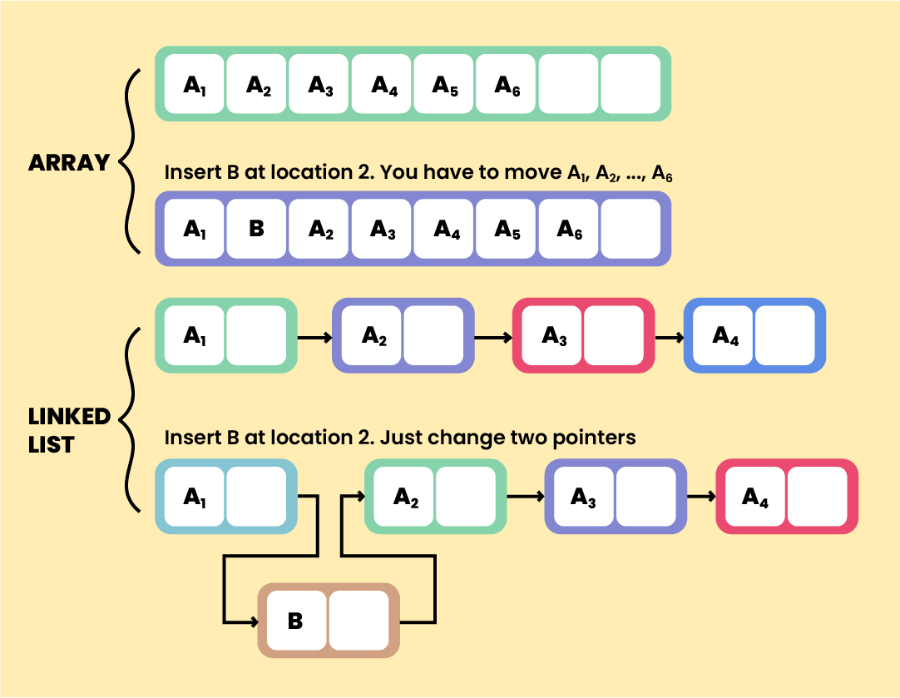

Slide 4
Linked list is a collection of nodes or data elements logically connected to each other.
Each node has two fields ‘data’ and ‘link’ or ‘next’.
The ‘data’ field stores actual piece of information and the ‘link’ or ‘next’ field is used to point to the next node or store the address of the next node.
The nodes (elements) in the linked list will be allocated randomly inside the memory.
If there is a need to add a new element to the list, a new node is created and appended at the list.

Slide 5
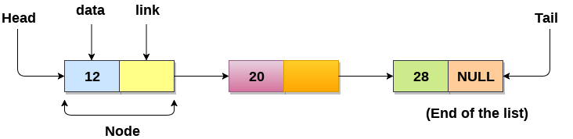
Representation of linked lists
Linked list can be visualized as a chain of nodes; where every node contains a data field and a reference link to the next node in the list.
The first node in the sequence is termed as ‘head’ or ‘first’.
The last node in the list is the one which points to ‘Null’ and termed as ‘tail’ or ‘last’.

Slide 6
/* Initialize nodes */
struct node *head;
struct node *nodeA = NULL;
struct node *nodeB = NULL;
struct node *nodeC = NULL;
/* Allocate memory */
nodeA = malloc(sizeof(struct node));
nodeB = malloc(sizeof(struct node));
nodeC = malloc(sizeof(struct node));
/* Assign data values */
nodeA->data = 1;
nodeB->data = 2;
nodeC->data = 3;
/* Connect nodes */
nodeA->next = nodeB;
nodeB->next = nodeC;
nodeC->next = NULL;
/* Save address of first node in head */
head = nodeA;
struct node {
int data;
struct node *next;
};

Slide 7
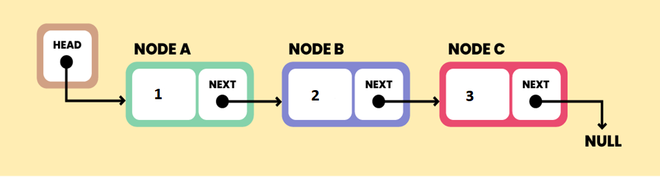

Slide 8
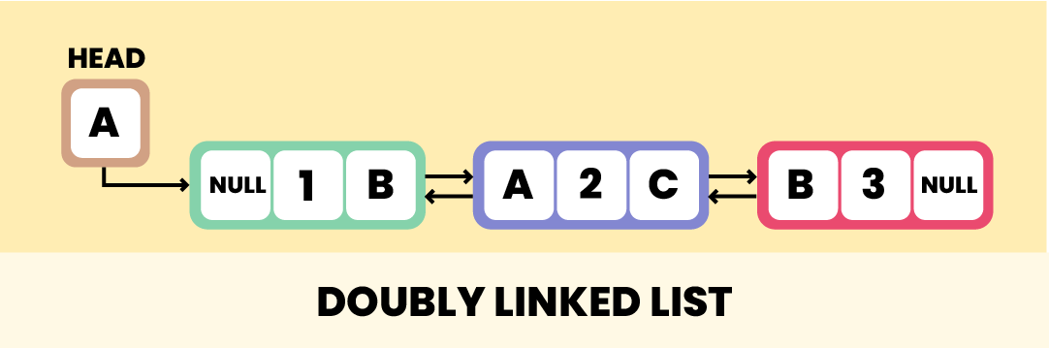
Linked list types

Slide 9
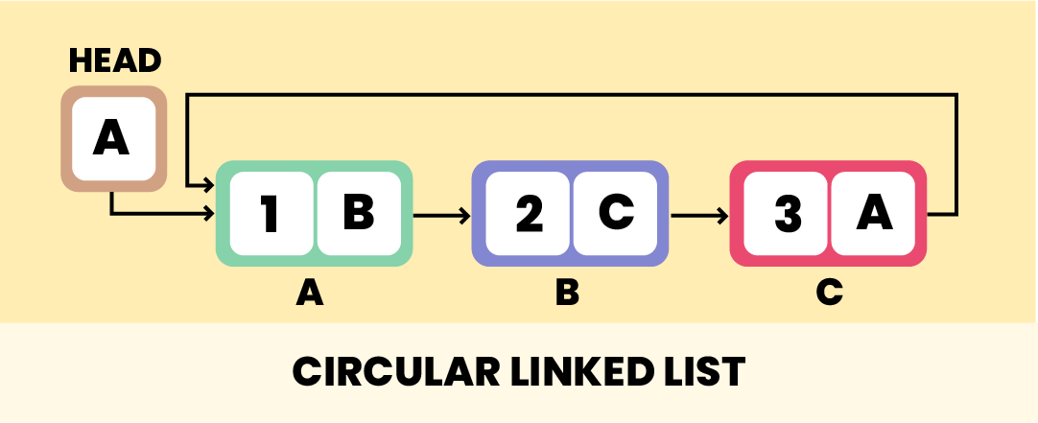
Linked list types

Slide 10
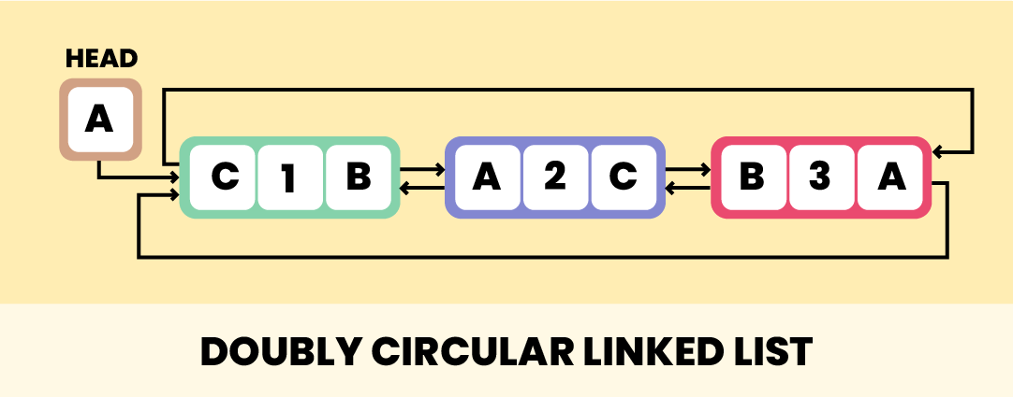
Linked list types

Slide 11
Operations in a linked list
Traversal - To access each element of the linked list.
Insertion - To add/insert a new node to the list.
Deletion - To remove an existing node from the list.
Search - To find a node in the list.
Sort - To sort the nodes.

Slide 12
Traverse a Linked List
Accessing or displaying the contents of a linked list is very simple.
Set a pointer (temp) to point to the head of the list and display its contents.
Keep moving the temp pointer to point to the next node and display its contents.
When the temp is NULL, this means that the end of the list have been reached.

Slide 13
temp
temp
temp
temp

Slide 14
Insert Elements to a Linked List
Elements can be inserted either in the beginning, middle, or end of the linked list.
Insert at the beginning
Allocate memory for the new node.
Store data.
Change next of new node to point to head.
Change head to point to the recently created node.

Slide 15
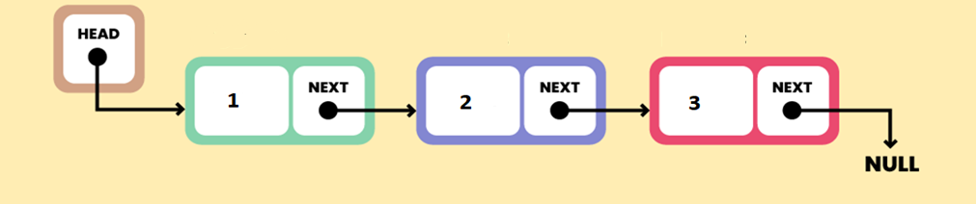
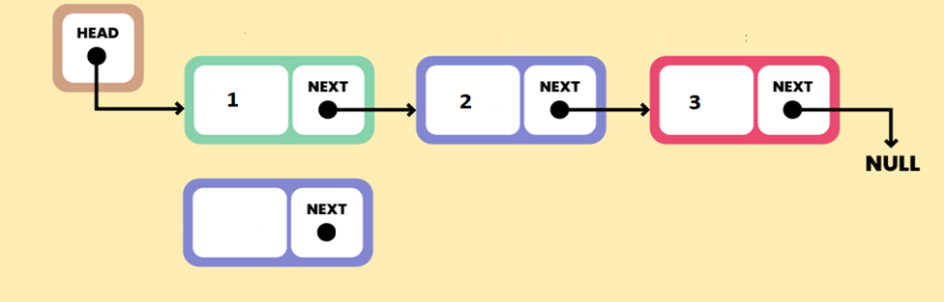
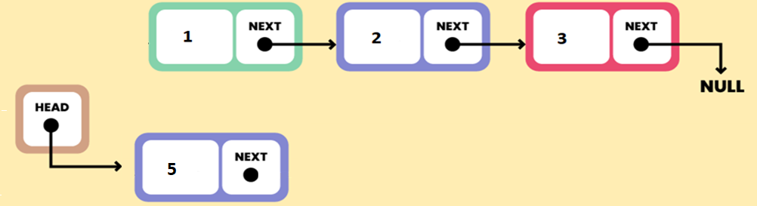
5

Slide 16
2. Insert at the Middle
Allocate memory and store data for the new node.
Traverse to node just before the required position of new node (?).
Change next pointers to include new node in between.

Slide 17
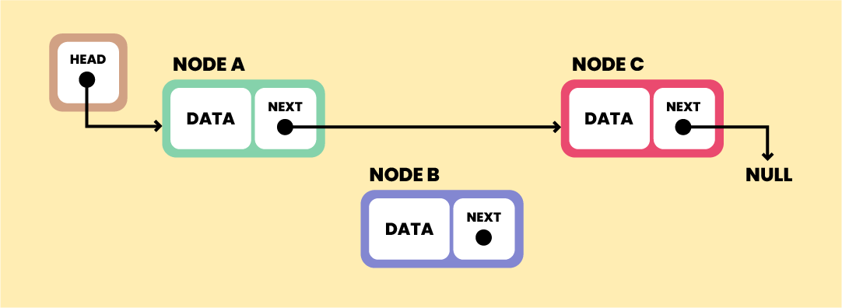
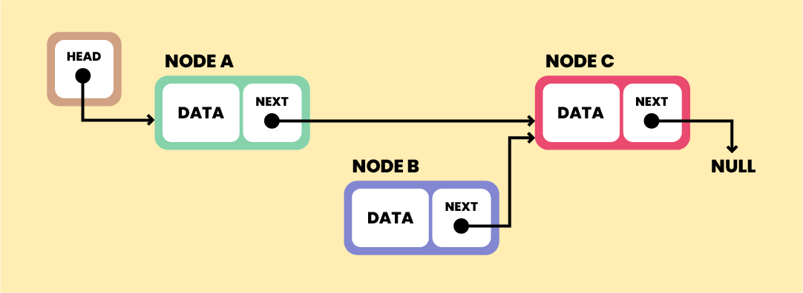
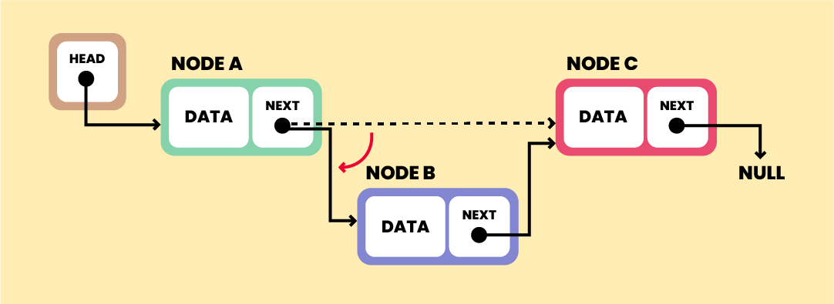
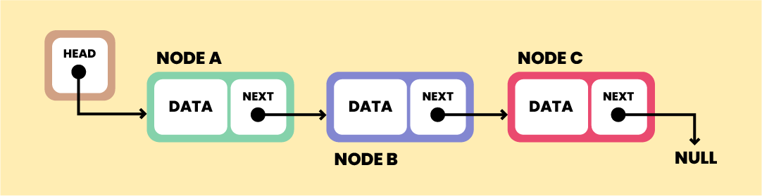

Slide 18
3. Insert at the End
Allocate memory for the new node.
Store data.
Traverse to the last node (?).
Change next of the last node to the recently created node.

Slide 19
temp
temp
temp

Slide 20
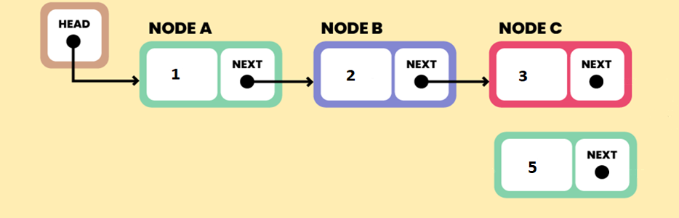
NULL

Slide 21
Delete from a Linked List
Deletion from linked list can be from the beginning, end, or from a particular position.
Delete from beginning
Set temp pointer to the head.
Point head to the second node
Free temp.

Slide 22
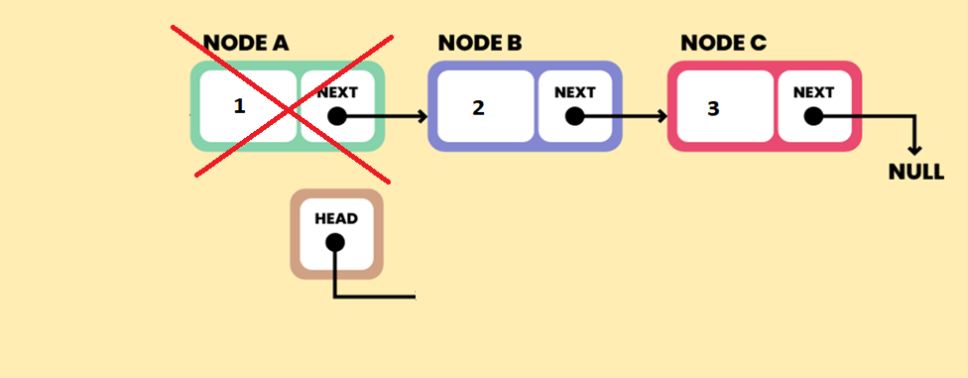
temp
temp

Slide 23
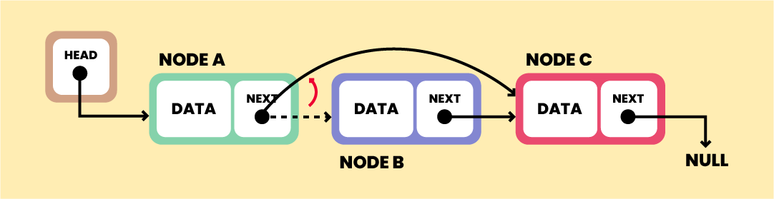

Delete from middle
Traverse to element before the element to be deleted (?).
Change next pointers to exclude the node from the chain.

Slide 24
Delete from end
Traverse to second last element (?).
Change its next pointer to null.
Free the deleted node(?).

Slide 25
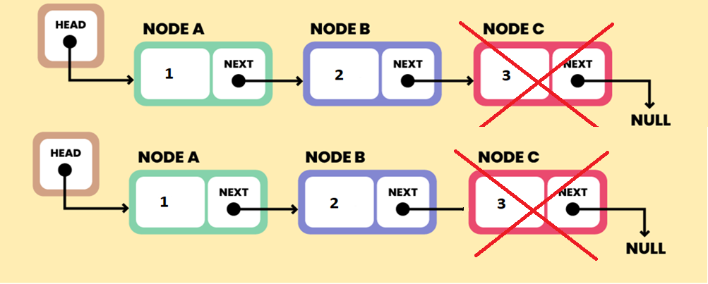
temp
temp
temp
temp
NULL

Slide 26
Search an Element on a Linked List
Set temp pointer to point to the head.
Run a loop until the current node is NULL because the temp points to NULL.
In each iteration, check if the key of the node is equal to item. If it the key matches the item, return true otherwise return false.
Sort the elements in the linked List?

Slide 27
Linked list applications
In web browsers
While moving through web pages, you have both options available - to either move to the next page or the previous page. This is only possible because of a doubly linked list.
In music players
Similarly, we can switch to the next and the previous song in a music player using links between songs. We can also play songs either from the starting or the end of the playlist.
In image viewer
The next and the previous photos are linked, and we can easily access them by using the previous and next buttons.

Slide 28
In operating systems
The thread scheduler uses a doubly-linked list to maintain the list of all processes running at any time. It enables us to move a certain process from one queue to another with ease.
In Multiplayer games
Online multiplayer games such as the likes of PUBG and Call of Duty use a circular linked list to swap between players in a loop.

Slide 29
Advantages of Linked List
Linked list is dynamic in nature which allocates the memory when required.
In linked list, stack and queue can be easily executed.
It reduces the access time.
Insert and delete operation can be easily implemented in linked list.
Disadvantages of Linked List
Reverse traversing is difficult in linked list.
Linked list has to access each node sequentially; no element can be accessed randomly.
In linked list, the memory is wasted as pointer requires extra memory for storage.

